Slide 1

Professional Ethics and You

Slide 2
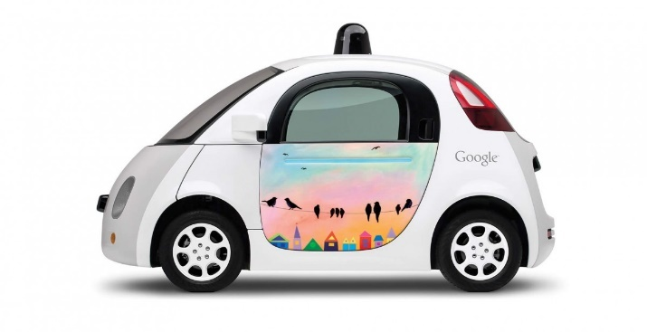
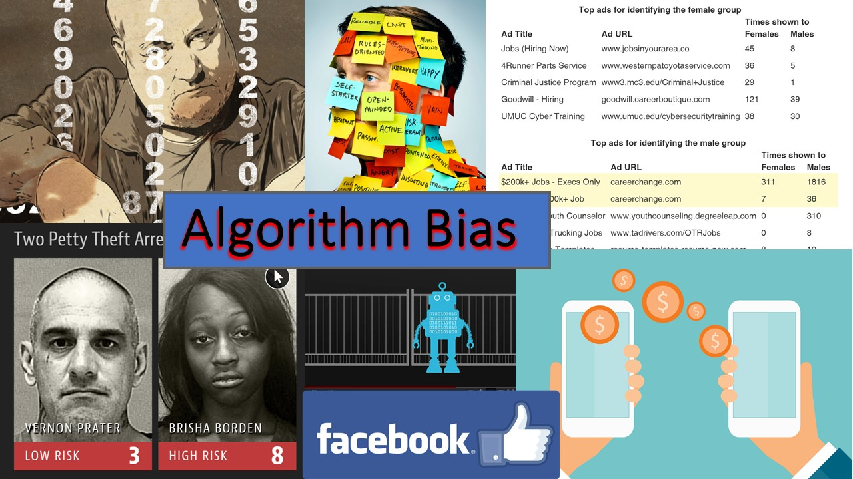

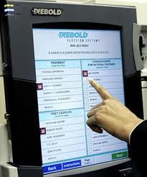


The Systems We Build

Slide 3
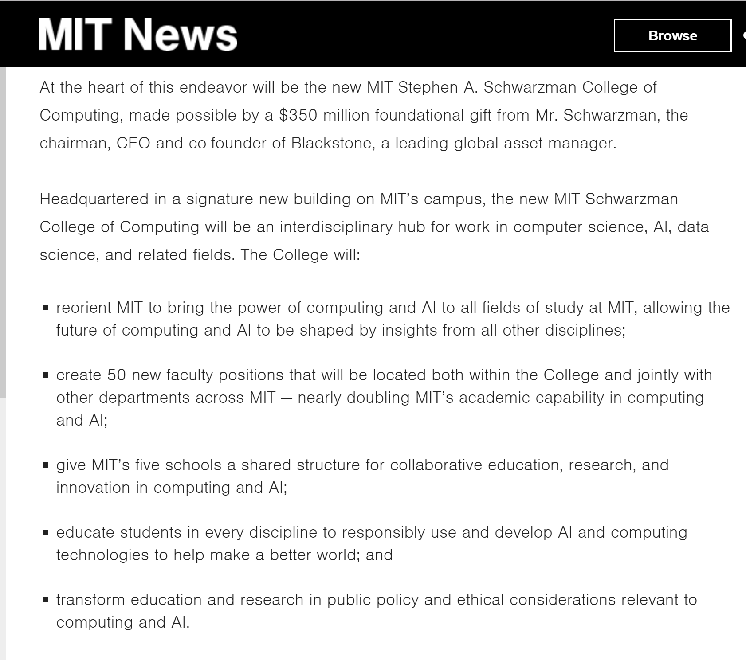
Notes:
http://news.mit.edu/2018/mit-reshapes-itself-stephen-schwarzman-college-of-computing-1015
Note last two bullet items. Particular emphasis on the need for ethics in thinking about AI.

Slide 4

Your Job
Notes:
https://www.nytimes.com/2020/01/11/style/college-tech-recruiting.html
How much do your principles matter in choosing a job? Can individual tech employees make a difference?

Slide 5


Get Involved
Notes:
https://www.clipartlogo.com/istock/politicians-people-vector-set-1733320.html
https://clipartart.com/categories/clipart-us-capitol-building.html

Slide 6

Why Is It So Important That Computer Professionals Get involved?
http://gizmodo.com/why-californias-new-web-wide-delete-button-for-teens-w-1377730365
Notes:
Why California’s new wide-wide delete button for teens won’t work.
Now all this sounds nice in theory, but more than anything, this law
is a testament to the fact that lawmakers (at least in California)
have no real idea how the internet actually works.

Slide 7



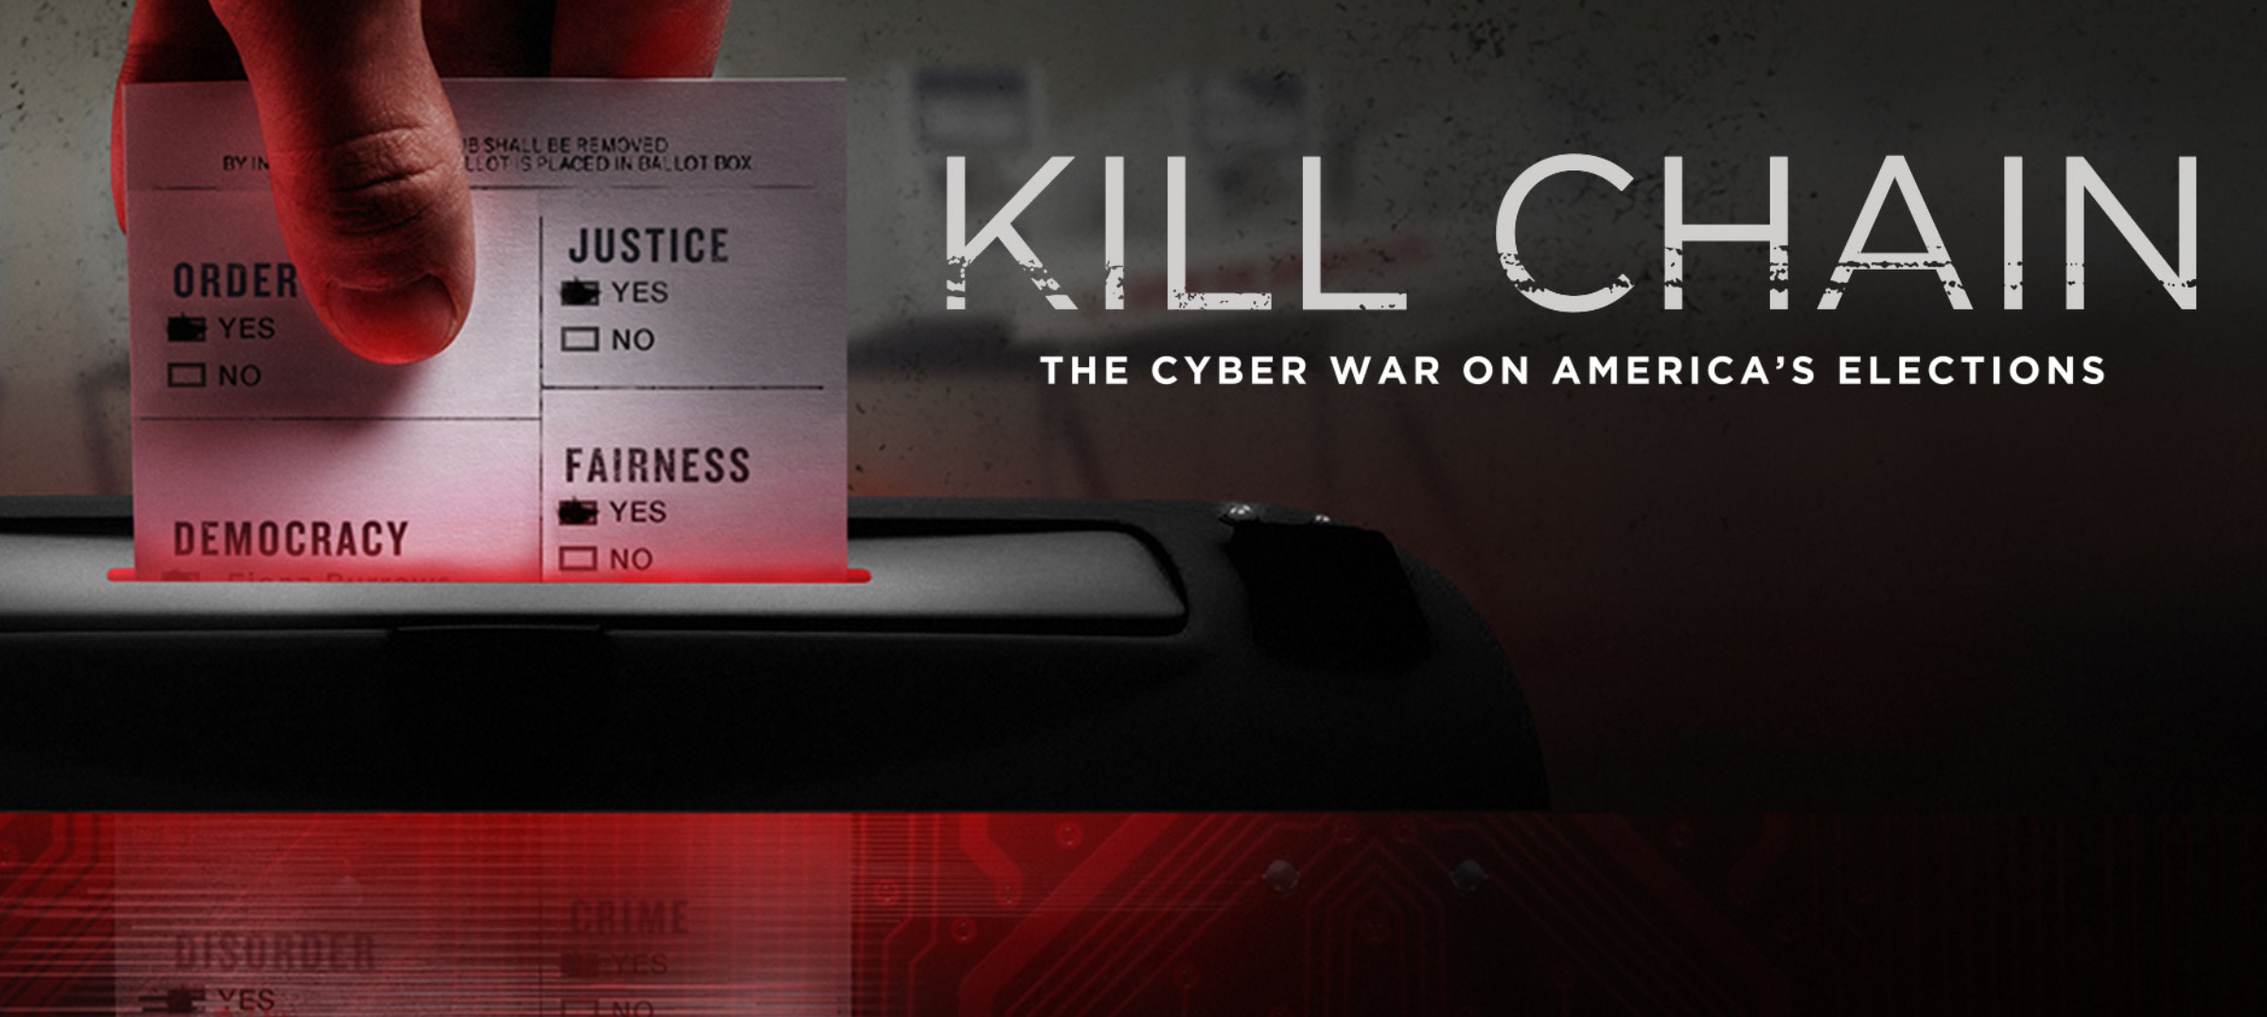
Why Is It So Important That Computer Professionals Get involved?
Notes:
https://www.pngitem.com/middle/iRJwiRx_transparent-i-voted-sticker-png-transparent-i-voted/
https://www.owensound.ca/en/city-hall/election_2018_internet_voting.aspx#

Slide 8
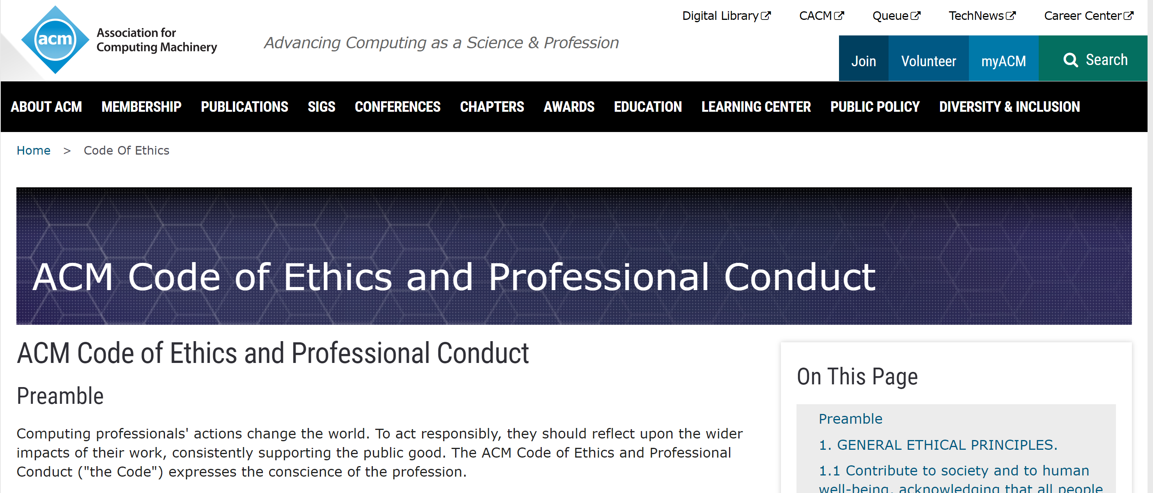
Professional Ethics
ACM Code of Ethics and Professional Conduct

Slide 9
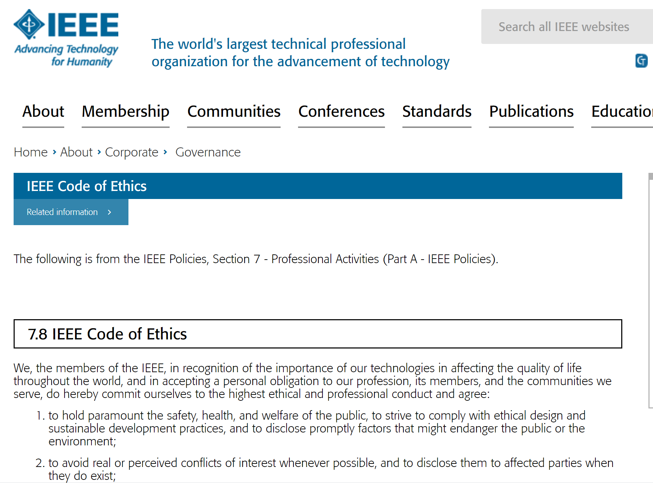
Professional Ethics
https://www.ieee.org/about/corporate/governance/p7-8.html

Slide 10

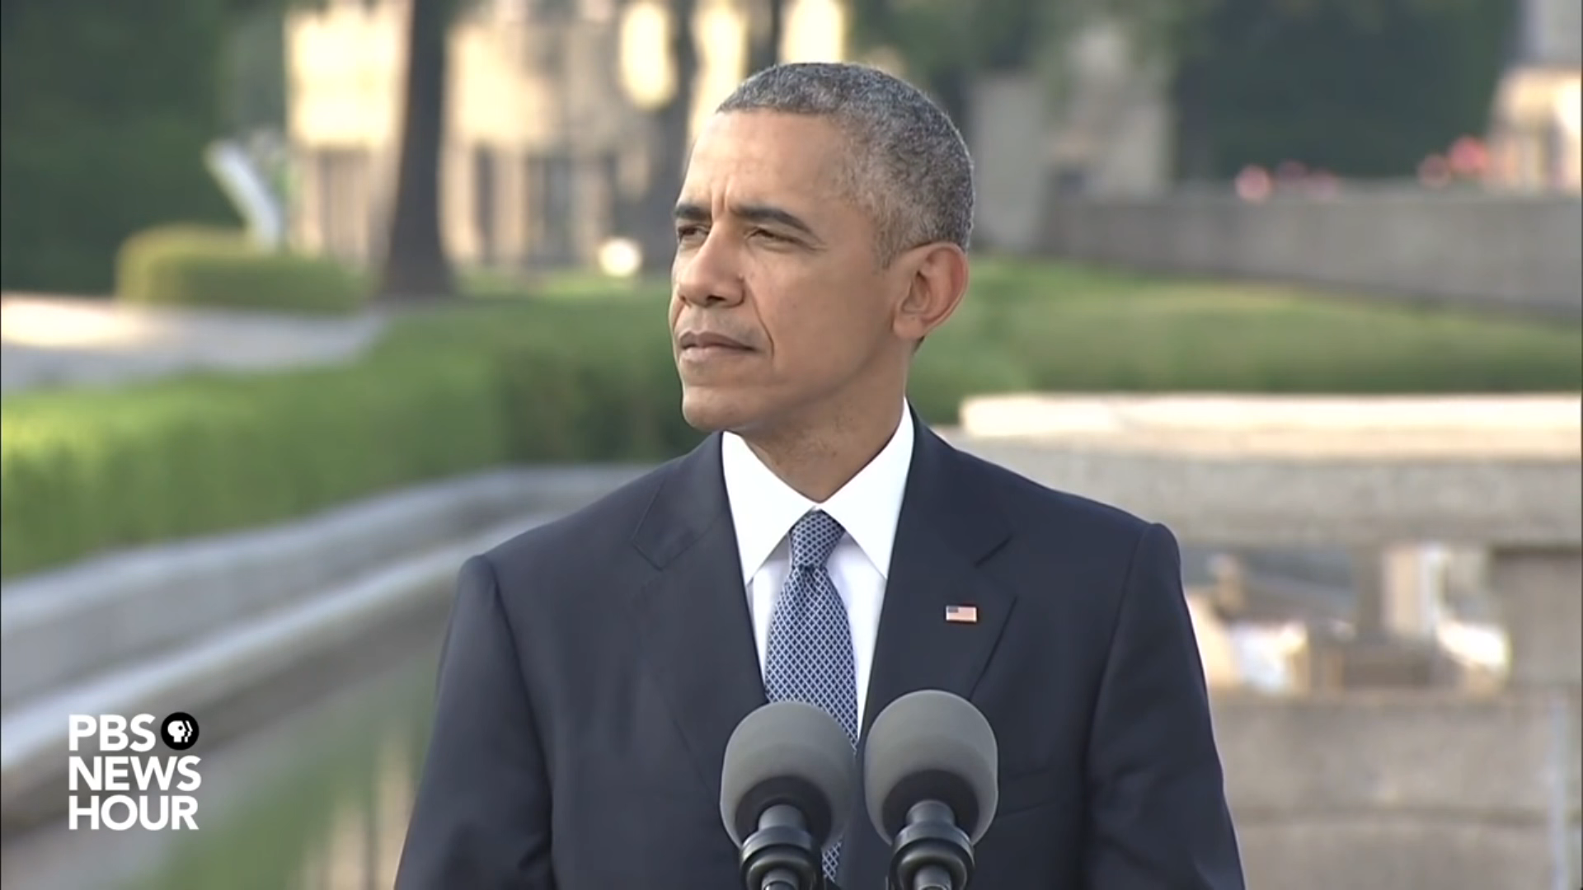
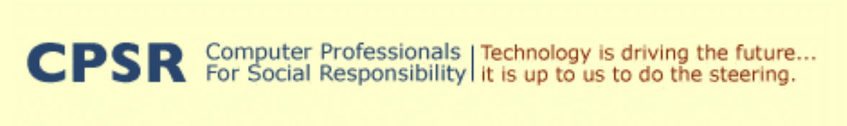

Are Science and Technology Morally Neutral?

